Slide 1
Leadership for Safety: Will and Transparency
Essential Hospitals Engagement Network
September 19, 2013

Slide 2
Our new Name
We’ve rebranded! The National Association of Public Hospitals and Health Systems is now America’s Essential Hospitals.
Although we’ve changed our name, our mission is the same: to champion hospitals and health systems that provide the highest quality of service to all by achieving the best health outcomes for every patient, especially those in greatest need. The new name underscores our members’ continuing public commitment and the essential nature of our work to care for the most vulnerable and provide vital community services, such as trauma care and disaster response.
This is an exciting time for us and our members, as we lean forward into new care models, opportunities and challenges of reform, and quality and safety innovations that often take root in our member systems.
Our new website address: www.EssentialHospitals.org

Slide 3
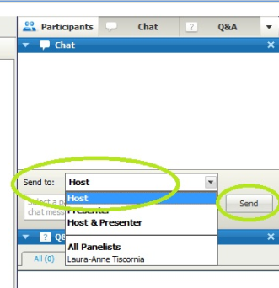
Chat feature
Please use the Chat Box on the webinar screen to type your question or comment at any time.
NOW: Use the Chat Box to sign in. Enter your organization and names of all people in the room.

Slide 4
Leadership and Attention
James L. Reinertsen, M.D.
jim@reinertsengroup.com

Slide 5
Seven Leverage Points: If you want to achieve system-level results in safety…
Set specific system-level aims and oversee their achievement at the highest levels of governance.
Build an executable strategy to achieve the aims, and oversee the execution at the highest levels of administration.
Channel attention to system-level aims and measures
Get patients and families on your team!
Engage the CFO in achieving the aims
Engage doctors in achieving the aims
Build the improvement capability necessary to achieve the aims
Notes:
This is a theory, not a recipe
It comes from three sources: complex adaptive systems theory, observation and case study of P2 and other organizations attempting to move big dots, and personal hunches/ideas and experience combined with data from management and leadership literature. It’s offered as a theory: “If you were to some combination of these things well, you would have a shot at moving big dots.” Or, perhaps it could be stated in the negative: “If you fail to do several of these things well, no matter what else you do, you will fail to move the big dots.”
We are looking for feedback from you, for suggestions on how to improve the theory.

Slide 6
“The currency of leadership is attention.”
Heifetz

Slide 7
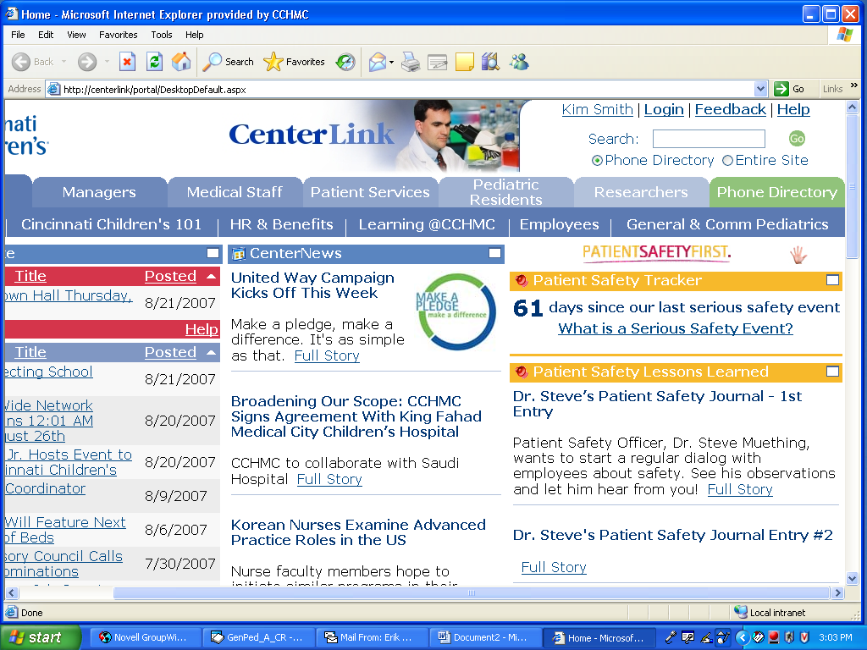

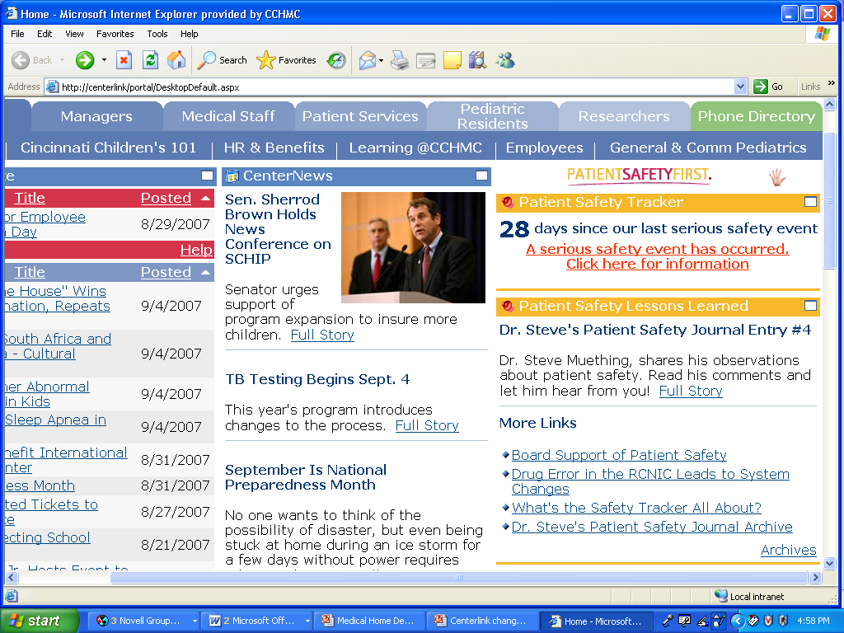
Courageous Transparency Driven by Cincinnati Children’s Board

Slide 8
Where are you on this spectrum?
We live in fear of our lawyer, and the media. We discuss safety and quality only in “super double secret.” Even the full Board doesn’t learn about everything.
We tell our Board, staff, patients and the public about our awards, and our islands of excellence. We put some, but not all performance data on our website.
Our quality and safety aims and data are freely available to all staff, patients, and the public.

Slide 9
The Dark Side of Transparency
Greater desire to see data on performance
Assessment, accountability
Research
Improvement
Data
Fear, compliance, defensiveness
Lower desire to see data on performance
Curiosity, questions

Slide 10
Ways to Channel Attention
Personal
Choices in calendar
Body language
Doing project reviews
Behavior-based observation rounds
Stories
What is top of mind?
Organizational
Transparency of data
Meeting agendas
Compensation
Promotion
Appointments

Slide 11
Let’s Hear Some Stories and Examples from: Riverside Regional Medical Center San Francisco General Hospital Harbor-UCLA

Slide 12

Riverside County Regional Medical Center
Arnold Tabuenca, MD, FACS
CMO, Riverside County Regional Medical Center
Professor of Surgery and Chair, Department of Surgery, University of California Riverside
Professor of Surgery, Loma Linda University

Slide 13
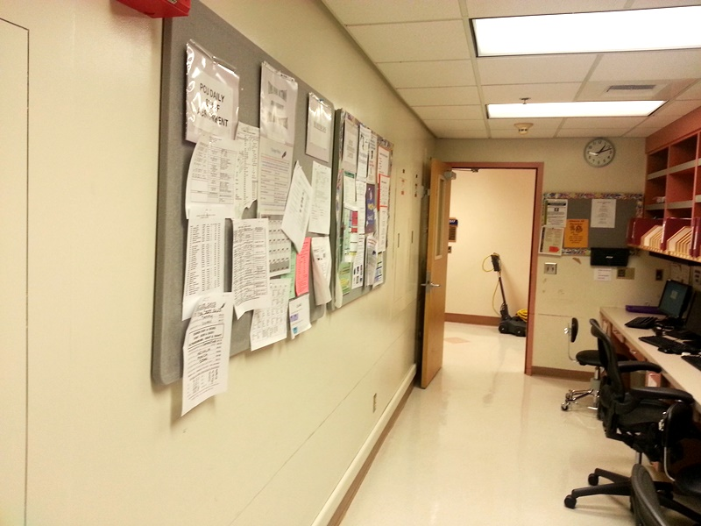
Signs at Riverside
Board in the doctors’ working area

Slide 14
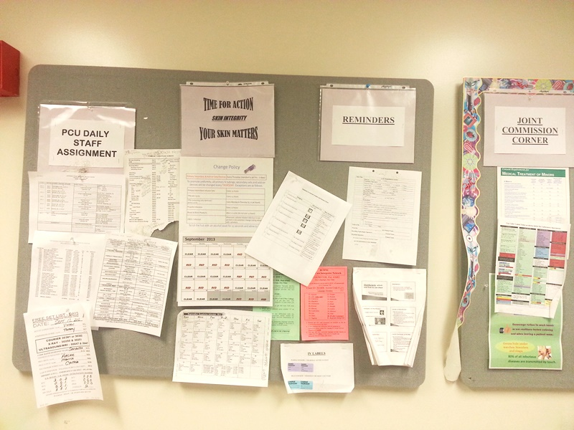
Signs at Riverside
Board #2 in the doctors’ working area

Slide 15
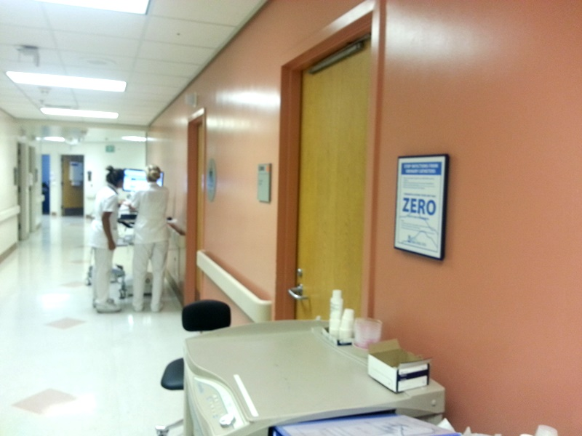
Signs at Riverside
New sign in the patient hallway

Slide 16
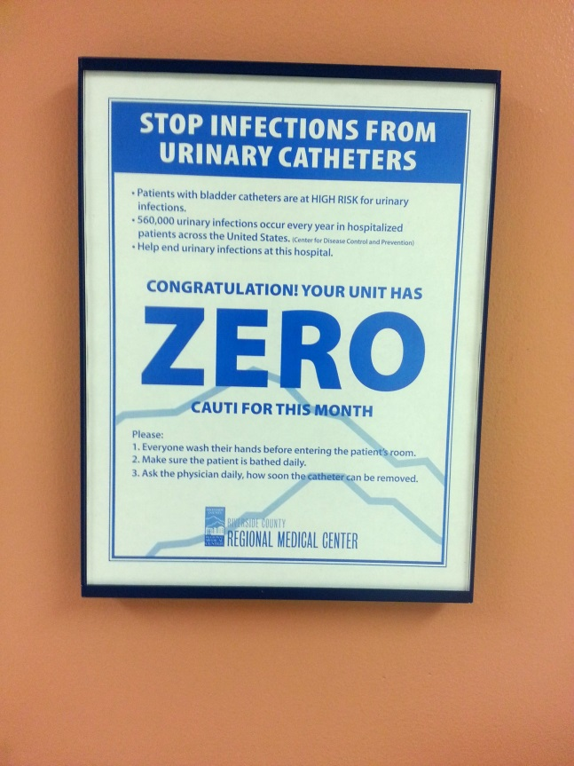
Signs at Riverside
New ZERO CAUTI sign in unit

Slide 17
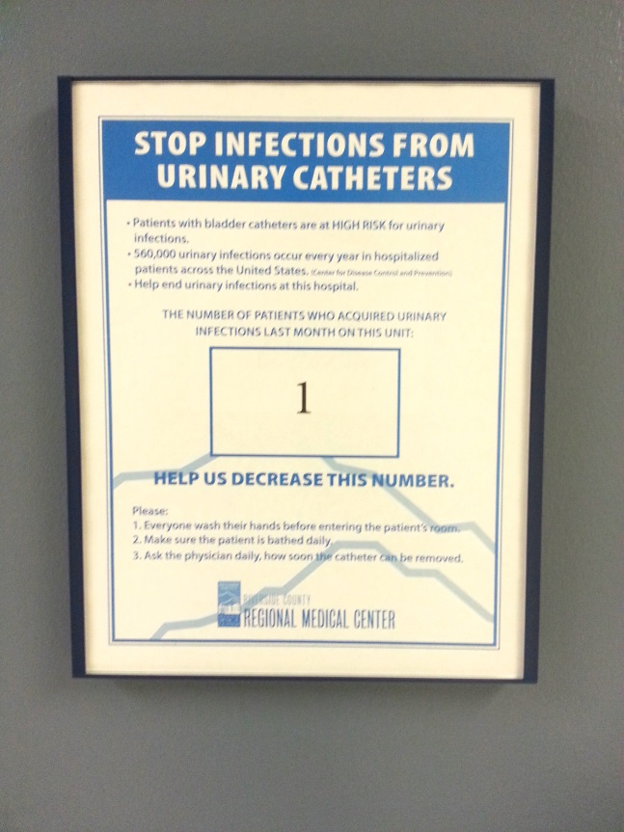
Signs at Riverside
New CAUTI sign in unit

Slide 18

San Francisco General Hospital
Thomas Holton MS, RN Patient Safety Officer &
Director of Education and Training San Francisco General Hospital and Trauma Center

Slide 19
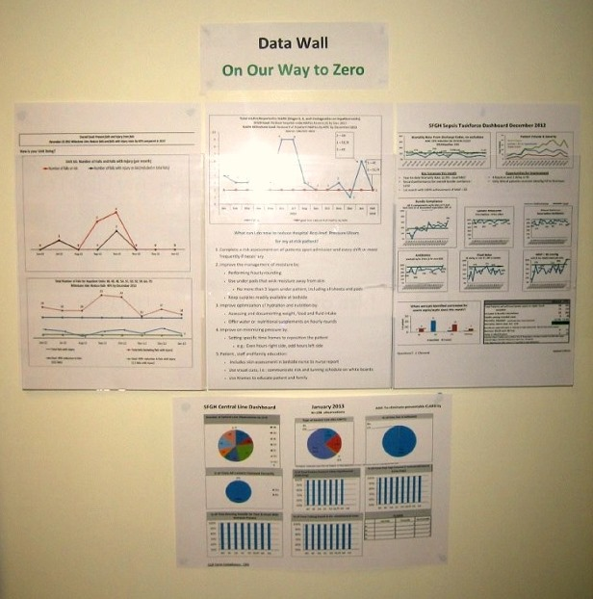
Data Wall

Slide 20
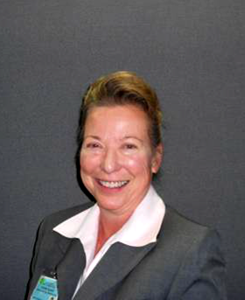
Harbor-UCLA
Susan Black, RN, MSN
Chief Kaizen Promotion Officer
Harbor-UCLA Medical Center

Slide 21
Improving Data Display Using PDSA
Unit Level Data: Phase 1
(Med/Surg Wards and ICUs)

Slide 22
“Your staff can’t speak to quality.”
Joint Commission Survey

Slide 23
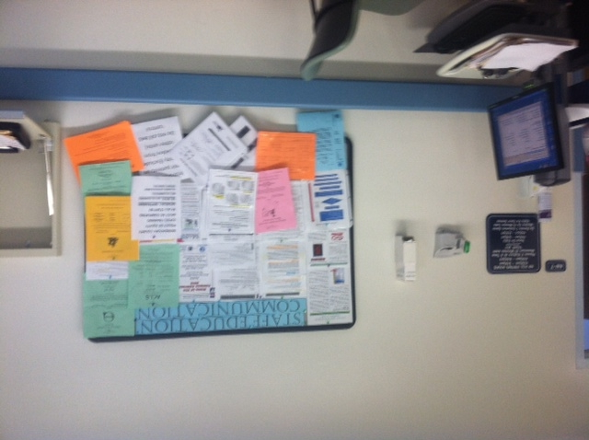
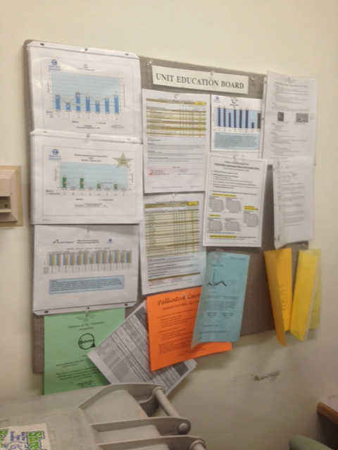
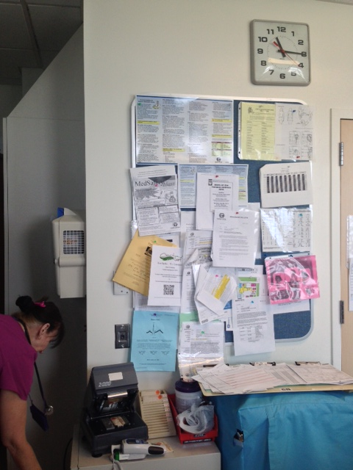
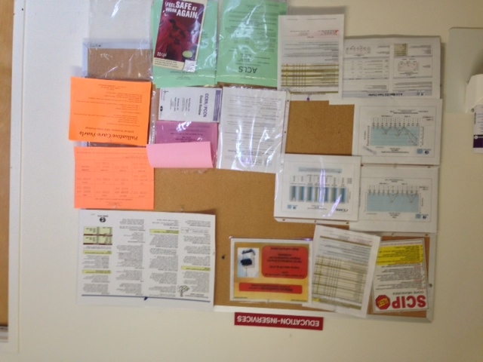
Wonder why?

Slide 24
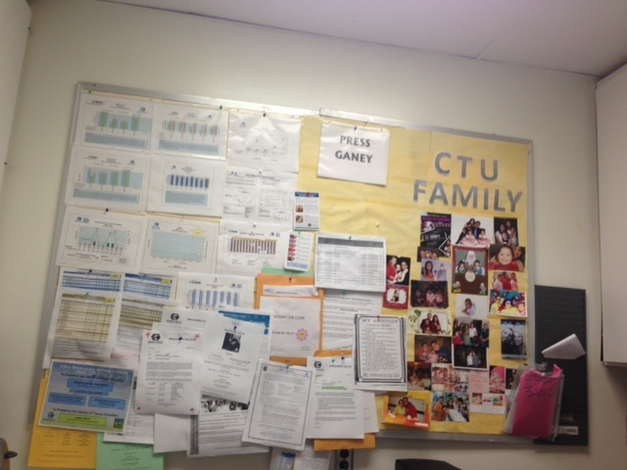
Background
No “dedicated” board for Quality & Safety
Data not timely often months (even years) old
Multiple formats used
Data not always unit specific
Data hard to read (no real analysis)
Unit based initiatives MIA!
No alignment to organizational priorities (no ties to goal to reduce harm by 40% by December 2013)
Quality & Safety Board?

Slide 25

Form a Team (Alpha Order)
Debbie Balster, RN (Lean)
Susan Black, RN (Quality)
Michele Bundalian, RN (Quality/Waiver)
Clinton Coil, MD (Patient Safety)
Lisa Kido, RN (Performance Improvement)
Arlene Malabanan, RN (Infection Prevention & Control)
Elizabeth Magsino (Quality)
Christine Nakagawa, PharmD (Pharmacy)
Randy Sattazahn, RN (Nursing)
Robin Watson (Quality)
Aim 1: Improve staff confidence in their ability to speak to quality 50% over baseline in Phase 1/ Med/Surg Wards and ICU’s by August 2013.
Aim 2: Promote goal of “Zero Harm” facility wide.

Slide 26
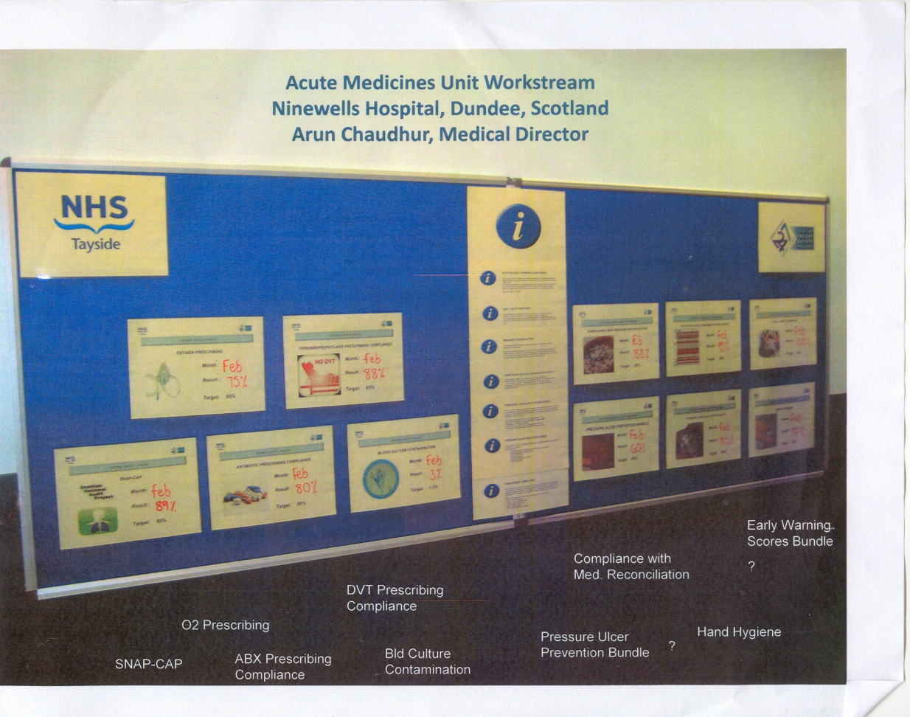
Plan: develop data display template
Must:
Be simple
Tell you where you are
Tell you what the target is
Tell you how to improve
Sample Data Display Presented by A. Frankel, MD at Harbor-UCLA, September 2012

Slide 27
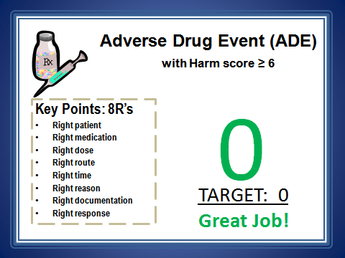
“Harborize” it…

Slide 28
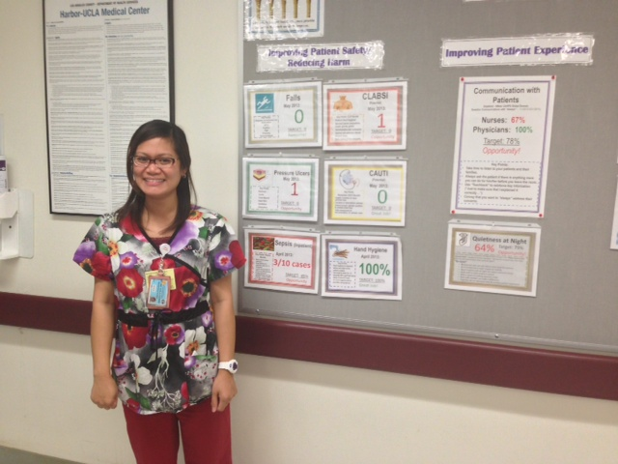
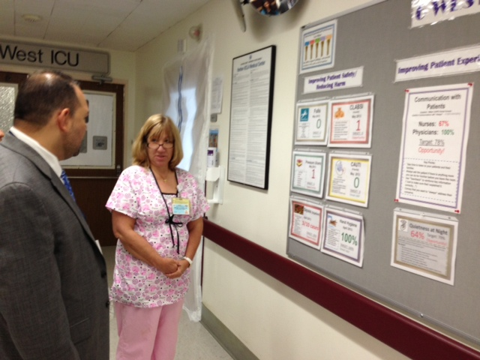
Do: Implemented on 6 West Test Unit
Small test of change (1 unit, 1 – 2 nurses)
Asked staff to “Tell me what you are doing to improve quality & safety”
Collected data: staff opinions (old vs. new data display)

Slide 29
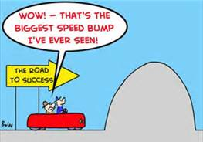
Bump in the road questions…
Do you remember when your last event was?
What were the lessons learned from that event?

Slide 30
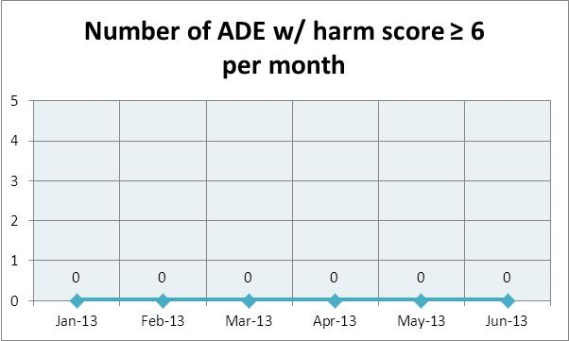
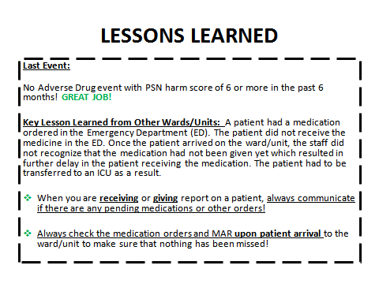
Addressed by adding…
No ADE w/ harm score ≥ 6 last six months: Great Job!
Simple run chart with analysis
Lessons Learned!
Notes:
6W, 6WICU, 5WICU, 5WRTU, 5E, 4WCCU, 4E, 3W, 3WICU, 3WCTU, 3E

Slide 31
Study… (Pilot Unit)
6 West Staff Opinions on Quality & Safety Board Display (June 27, 2013)
n=6
Scale:
1. Strongly Disagree
2. Disagree
3. Neutral
4. Agree
5. Strongly agree
Staff confidence in speaking about quality improved (doubled)
Staff “agreed” we should roll out “new” display boards facility-wide.

Slide 32
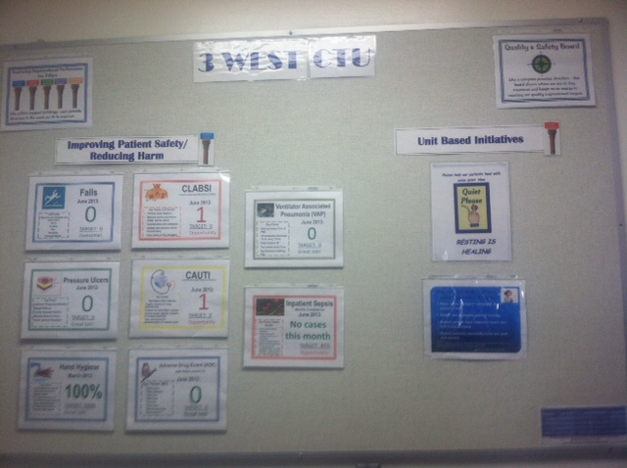
Act: Roll out the new boards to Med/Surg Wards & ICUs (Phase I)
“OLD” Data Display Board
“New” Data Display Board

Slide 33
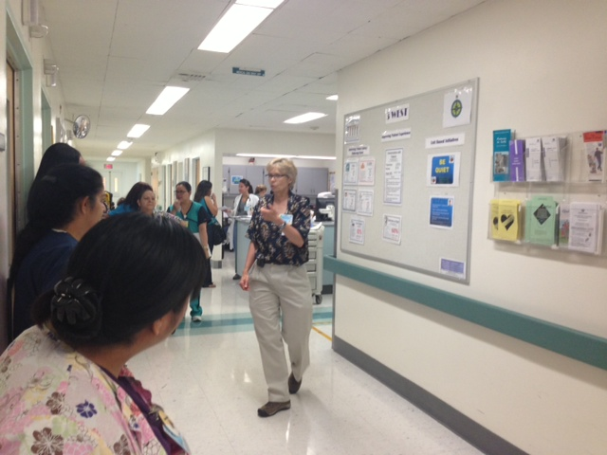
Education!
Helping staff to “connect the dots” between daily work and outcomes (monthly as data are posted)

Slide 34
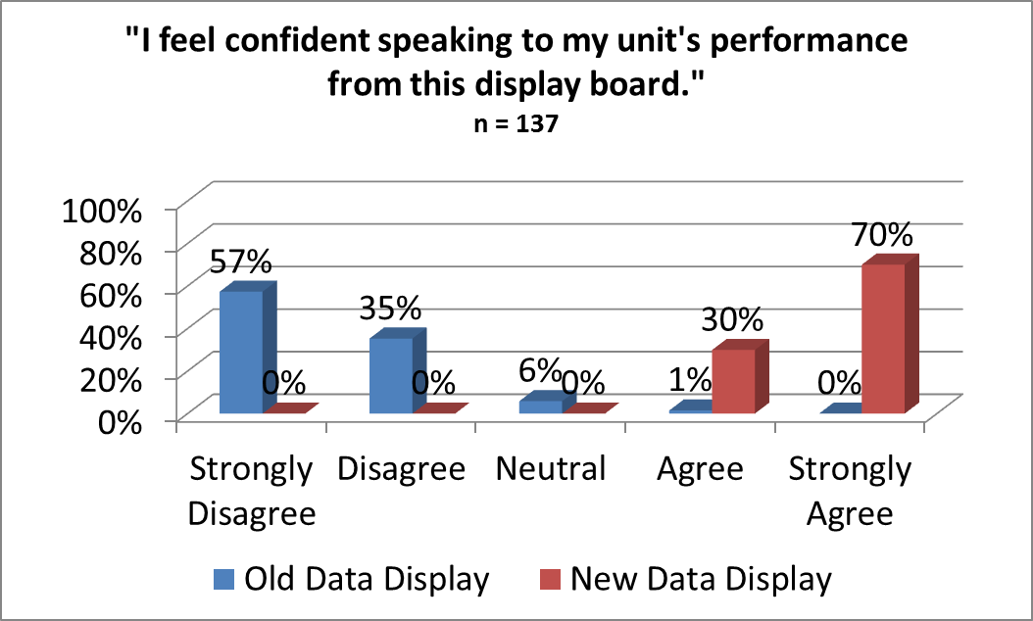
Study (Again…)
Aim 1: We met/exceeded our goal to improve staff’s confidence in their ability to speak to quality & safety 50% over baseline (1% to 100%).

Slide 35
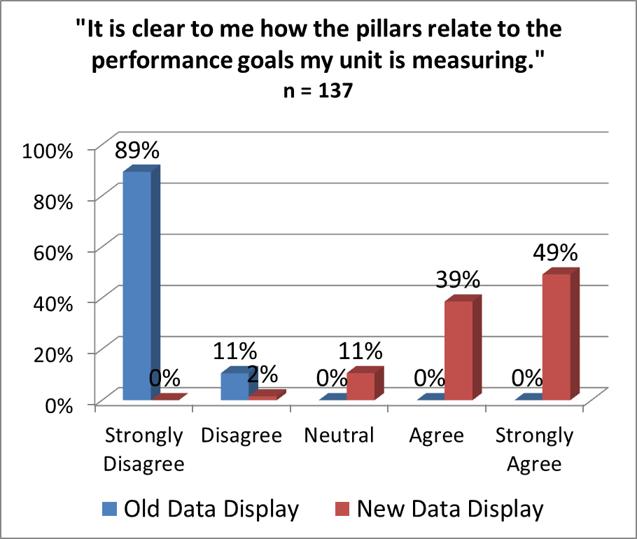

Improving alignment…
Rapid Cycle Improvements (based on staff suggestions):
Added “mini pillars” to board
Color coding of data border to match pillars to improve “connections”

Slide 36
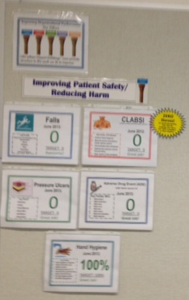

Aim 2: Promote Goal of “Zero Harm”
ZERO Heroes!
An Award Recognizing Your Unit for Achieving Zero Harm and 100% Compliance to Hand Hygiene!
June 2013 Screen Saver!

Slide 37
Summary
“Staff can’t speak to quality”- We were the problem!
Format- remember KISS.
Data must be timely and unit-specific.
Seek frequent staff feedback on boards/data display with rapid cycle improvements
Unit “owns” the data & performance; Q & S Board Team “owns” the responsibility to update boards and be a resource to promote performance improvement!
Improving data display is key to improving staff’s confidence in their ability to speak to quality/safety data and we believe the key to ultimately improving outcomes.

Slide 38
Q & S Board Next Steps…
Phase I (Med/Surg Wards & ICUs)
(August 30, 2013)
6 West
6 West ICU
5 West ICU
5 West RTU
5 East
4 West
4 West CCU
4 East
3 West
3 West ICU
3 West CTU
3 East
Phase II (Remaining inpatient units, OR & ED)
(December 30, 2013)
8 West
1 South CRU
7 West
7 L & D
6 East Peds
6 East ICU
6 East NICU
OR
ED
Phase III & IV
(TBD)
Outpatient Clinics including Dialysis; Infusion
Other Departments (Pharmacy, Nutrition, etc.)
Completed July 15, 2013- a month a head of schedule
Target Date: December 2013
Target Date TBD

Slide 39
Next Steps Continued…
Formalize standard work around monthly/ quarterly updates
Continue to seek staff feedback with rapid cycle response/improvements to boards/data display
Ultimate goal: Shift huddles where quality/safety is the focus. Transition from: What happened last month? to: What happened last shift and how can we make our patients safer?
Quality
Outcomes
My Work
Data
Safety
“Safe Harbor”
Your Work
Staff
Patients
Transformation!

Slide 40
Save the date
Leadership for Safety: Yes, it’s Personal
A Workshop for CEOs, Board Members and C-Suite Leaders
October 7, 2013
9:30 am – 4:30 pm Pacific
San Mateo Marriott | San Mateo, Calif.
Deadline to register: Sept. 23, 2013
More information: http://tc.nphhi.org/Archive/EHEN-Events/Leadership-for-Safety-Yes-Its-Personal-A-Workshop-for-CEOs-Board-Members-and-C-Suite-Leaders

Slide 41
Thank you for attending
Next Leadership webinar: November 14 @ 12 pm Eastern
Evaluation: Feedback survey can be accessed in the chat box.
Essential Hospitals Engagement Network website: http://tc.nphhi.org/Collaborate

